Slide 1
Introduction to NLP

Slide 2


Technologies
Speech recognition
  Spoken language is recognized and transformed in into text as in dictation systems, into commands as in robot control systems, or into some other internal representation.
Speech synthesis
  Utterances in spoken language are produced from text (text-to-speech systems) or from internal representations of words or sentences (concept-to-speech systems)
Introduction to NLP

Slide 3


Technologies
Text categorization
  This technology assigns texts to categories. Texts may belong to more than one category, categories may contain other categories. Filtering is a special case of categorization with just two categories.
Text Summarization
  The most relevant portions of a text are extracted as a summary. The task depends on the needed lengths of the summaries. Summarization is harder if the summary has to be specific to a certain query.
Introduction to NLP

Slide 4


Technologies
Text Indexing
  As a precondition for document retrieval, texts are stored in an indexed database. Usually a text is indexed for all word forms or – after lemmatization – for all lemmas. Sometimes indexing is combined with categorization and summarization.
Text Retrieval
  Texts are retrieved from a database that best match a given query or document. The candidate documents are ordered with respect to their expected relevance. Indexing, categorization, summarization and retrieval are often subsumed under the term information retrieval.
Introduction to NLP

Slide 5


Technologies
Information Extraction
  Relevant information pieces of information are discovered and marked for extraction. The extracted pieces can be: the topic, named entities such as company, place or person names, simple relations such as prices, destinations, functions etc. or complex relations describing accidents, company mergers or football matches.
Data Fusion and Text Data Mining
  Extracted pieces of information from several sources are combined in one database. Previously undetected relationships may be discovered.
Introduction to NLP

Slide 6


Technologies
Question Answering
  Natural language queries are used to access information in a database. The database may be a base of structured data or a repository of digital texts in which certain parts have been marked as potential answers.
Report Generation
  A report in natural language is produced that describes the essential contents or changes of a database. The report can contain accumulated numbers, maxima, minima and the most drastic changes.
Introduction to NLP

Slide 7
Regular Expressions

Slide 8
Regular Expressions
In computer science, RE is a language used for specifying text search string.
A regular expression is a formula in a special language that is used for specifying a simple class of string.
Formally, a regular expression is an algebraic notation for characterizing a set of strings.
RE search requires
  a pattern that we want to search for, and
  a corpus of texts to search through.
Regular Expressions and Automata

Slide 9
Regular Expressions
A regular expression search function will search through the corpus, returning all texts that match the pattern.
For example, the Unix command-line tool grep takes a regular expression and returns every line of the input document that matches the expression.
Regular Expressions and Automata

Slide 10
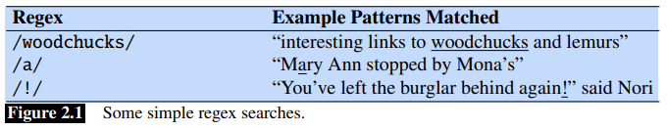
Basic Regular Expression Patterns
The simplest kind of regular expression is a sequence of simple characters; putting characters in sequence is called concatenation.
To search for woodchuck, we type /woodchuck/.
Regular expressions are case sensitive; lower case /s/ is distinct from upper case /S/. This means that the pattern /woodchucks/ will not match the string Woodchucks.
Introduction to NLP

Slide 11
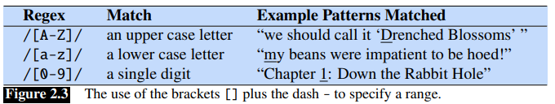
Basic Regular Expression Patterns
The string of characters inside the braces specifies a disjunction of characters to match.
The use of the brackets [] to specify a disjunction of characters.
The regular expression /[1234567890]/ specifies any single digit.
there is a well-defined sequence associated with a set of characters, the brackets can be used with the dash (-) to specify any one character in a range.
Regular Expressions and Automata

Slide 12
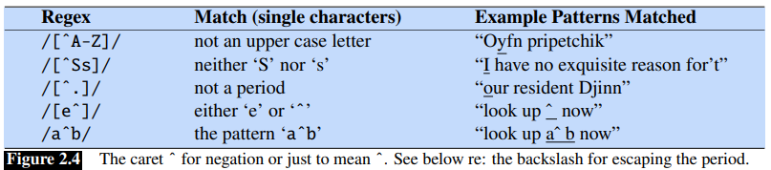

The square braces can also be used to specify what a single character cannot be, by use of the caret ˆ.
If the caret ˆ is the first symbol after the open square brace [, the resulting pattern is negated.
The question-mark ? marks optionality of the previous expression.
Introduction to NLP

Slide 13
The Kleene star means “zero or more occurrences of the immediately previous character or regular expression”.
So /a*/ means “any string of zero or more a’s”
Kleene +, which means “one or more occurrences of the immediately preceding character or regular expression”.
So /a+/ means “any string of one or more a’s”
Sheep Language
baa!
baaa!
baaaa!
baaaaa!
There are thus two ways to specify the sheep language:
/baaa*!/ or /baa+!/.
Regular Expressions and Automata

Slide 14
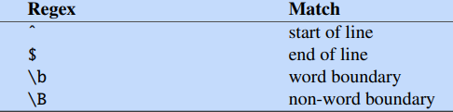
The use of the period . to specify any character.
The period (/./), a wildcard expression that matches any single character (except a carriage return)
Anchors are special characters that anchor regular expressions to particular places.
The most common anchors are the caret ˆ and the dollar sign $.
The caret ˆ matches the start of a line. The dollar sign $ matches the end of a line.
/ˆThe dog\.$/ matches a line that contains only the phrase The dog.

Slide 15
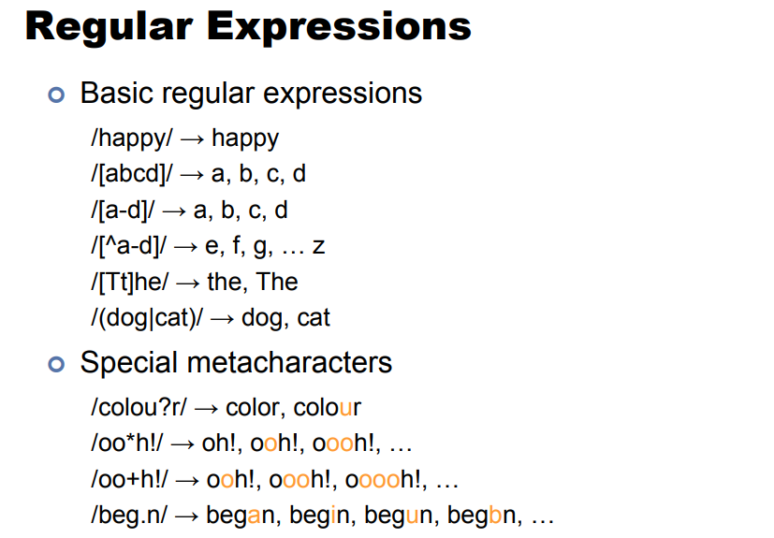
Introduction to NLP

Slide 16
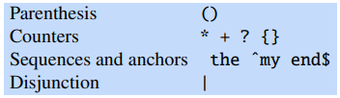
Disjunction, Grouping, and Precedence
Disjunction operator, also called the pipe symbol |.
The pattern /cat|dog/ matches either the string cat or the string dog.
How can I specify both guppy and guppies?
We cannot simply say /guppy|ies/, because that would match only the strings guppy and ies.
sequences like guppy take precedence over the disjunction operator |
Use the parenthesis operators ( and ). the pattern /gupp(y|ies)/
Operator precedence hierarchy

Slide 17
A Simple Example
we wanted to write a RE to find cases of the English article the
A simple (but incorrect) pattern might be: /the/
will miss the word when it begins a sentence and hence is capitalized (i.e., The).
/[tT]he/
we need to specify that we want instances with a word boundary on both sides:
/\b[tT]he\b/
We need to specify that we want instances in which there are no alphabetic letters on either side of the the:
/[ˆa-zA-Z][tT]he[ˆa-zA-Z]/
Before the ‘the’ we require either the beginning-of-line or a non-alphabetic character, and the same at the end of the line:
/(ˆ|[ˆa-zA-Z])[tT]he([ˆa-zA-Z]|$)/

Slide 18
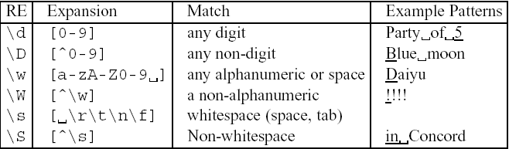
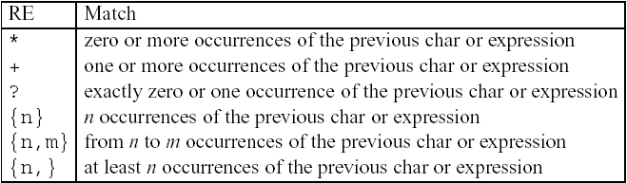
More Operators
Aliases for common sets of characters
Regular expression operators for counting

Slide 19
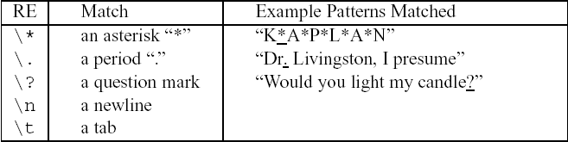
Some characters that need to be backslashed
Regular Expressions and Automata

Slide 20
The user might want “any machine with at least 6 GHz and 500 GB of disk space for less than $1000”
Here’s a regular expression for a dollar sign followed by a string of digits /$[0-9]+/
Now we just need to deal with fractions of dollars. We’ll add a decimal point and two digits afterwards: /$[0-9]+\.[0-9][0-9]/
This pattern only allows $199.99 but not $199. We need to make the cents optional and to make sure we’re at a word boundary: /(ˆ|\W)$[0-9]+(\.[0-9][0-9])?\b/
This pattern allows prices like $199999.99 which would be far too expensive! We need to limit the dollars:
/(ˆ|\W)$[0-9]{0,3}(\.[0-9][0-9])?\b/
We’ll need to allow for optional fractions again (5.5 GB); note the use of ? for making the final s optional, and the use of / */ to mean “zero or more spaces” since there might always be extra spaces lying around:
/\b[0-9]+(\.[0-9]+)? *(GB|[Gg]igabytes?)\b/

